Slide 1
PROBLEMS
A single cylinder vertical engine has a bore of 30 cm and a stroke of 40 cm. The connecting rod is 100 cm long. The mass of the reciprocating part is 140 kg. On the expansion stroke gas pressure is 7.0 MPa when crank angle is 45 degree. If the engine runs at 700 rpm, determine: (i) piston effort, (ii) gudgeon pin load, (iii) cylinder wall thrust, (iv) crank pin effort, (v) thrust on bearing and (vi) turning moment on the crank shaft. (Ans: 389.8 kN, 393.9 kN, 55.71 kN, 315.1 kN, 236.3 kN, 63.0 kNm)
A double acting horizontal gas engine running at 210 rpm has a bore of 220 mm and stroke of 440 mm. The connecting rod is 924 mm long and the reciprocating parts weigh 20 kg. When the crank has turned through an angle of 30 degree from the IDC, the gas pressures on the cover side and crank sides are 500 kPa and 60 kPa respectively. Diameter of the piston rod is 40 mm. Determine: (i) piston effort, (ii) turning moment on the crank shaft and (iii) acceleration of the flywheel (fitted on the crank shaft) which has a mass of 8 kg and radius of gyration of 600 mm while the power of the engine is 22 kW. (Ans: 14.14 kN, 1.954 kNm, 331.23 rad/s²)
A vertical petrol engine 10 cm diameter by 15 cm stroke has a connecting rod 26 cm long. The mass of the piston is 1.25 kg. Engine speed is 2000 rpm. On the explosion stroke, when the piston is quarter stroke length away from TDC, the gas pressure is 750 kPa. Determine: (i) piston effort, (ii) resultant load on gudgeon pin, (iii) turning moment and (iv) the speed above which, all other things remaining the same, gudgeon pin load will reverse in direction. (Ans: 3.81 kN, 3.92 kN, 270 Nm, 3355 rpm)

Slide 2
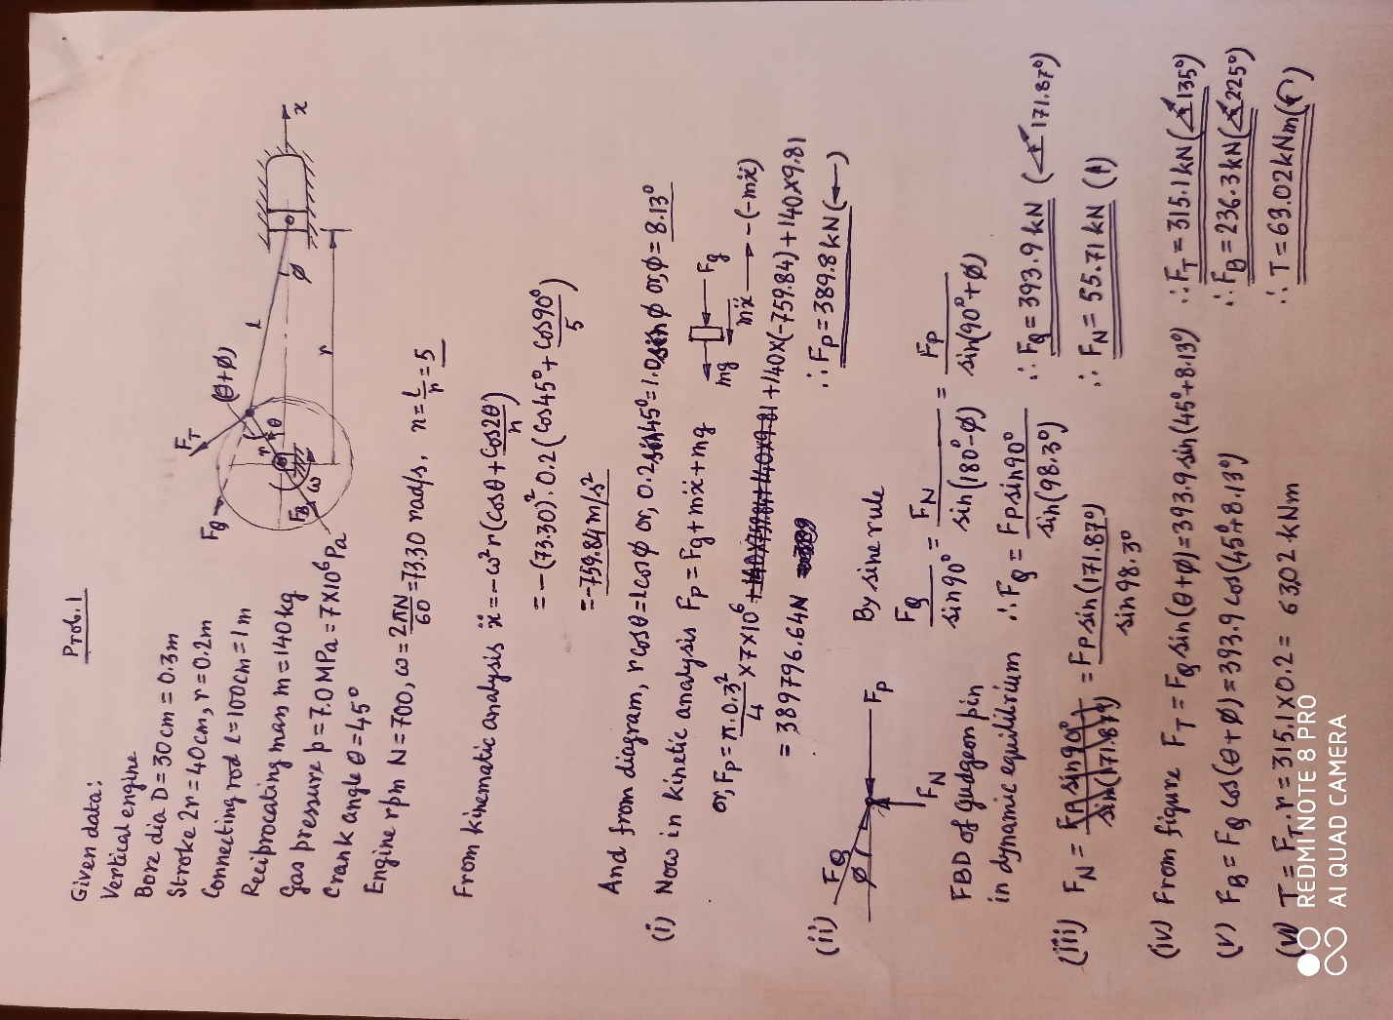
SOLUTION OF PROB 1

Slide 3
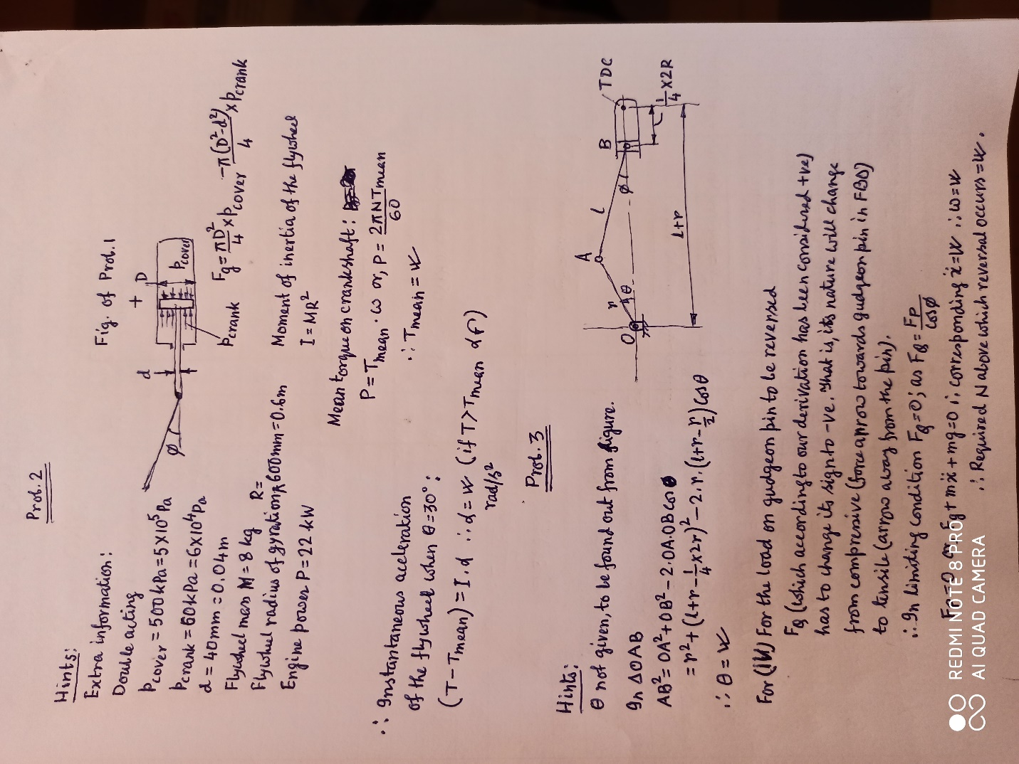
HINTS FOR PROBS 2 AND 3

